Slide 1
Assignment 1 Introduction to Data Analysis (DATA 1200)
Dheer Parikh
100919437

Slide 2
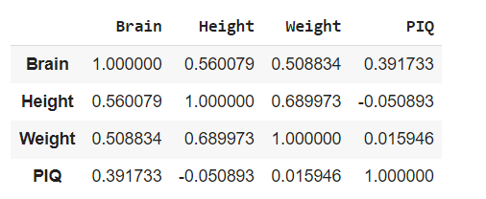
Co-Relation between dependent and independent variables:
From the correlation map it can be seen that height and weight have minimum or no correlation with PIQ, whereas, brain have correlation with PIQ of just 0.39
There is highest correlation between height and weight which is 0.69
There is 0.56 correlation between brain size and height which is low with respect to correlation between height and weight. Whereas, Brain size and height have correlation of 0.50 with is slightly less with respect to brain size and height.

Slide 3
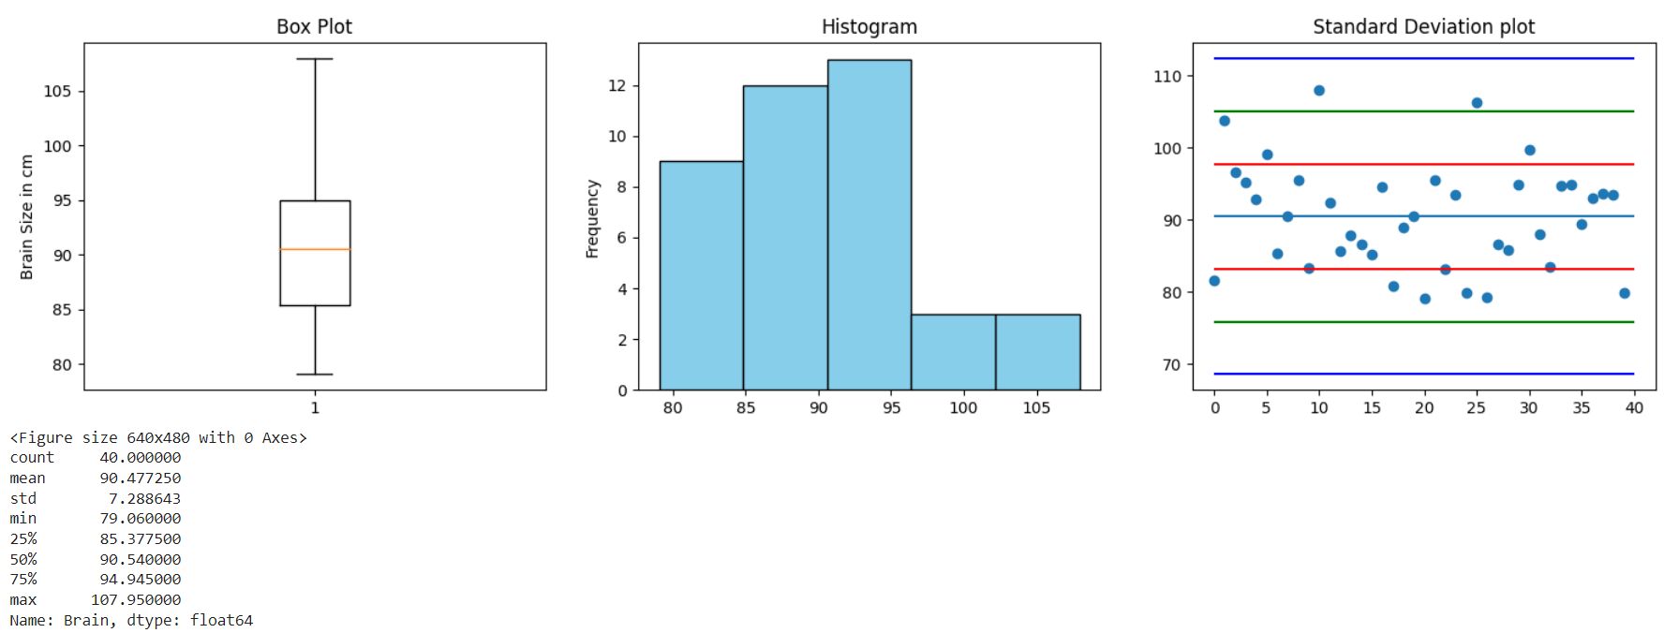
Detail description of Brain size Variable:
From the histogram it can be seen that data is left skewed and also it can be verified from the box plot and standard deviation plot.
From the standard deviation plot it can be seen that most of the data points lies in 1st quadrant.
From the boxplot it can be deduced that IQR for brain size is between 85 to 95 cm in circumference.
The difference between median and mean is not much significant and hence to describe this variable, any of them can be used. However, in such cases it is advisable to use mean as there are no outliers.
The smallest size of brain is 79.06 cm and largest is 107.25 cm. The spread of data from mean (standard deviation) is 7.29 cm

Slide 4
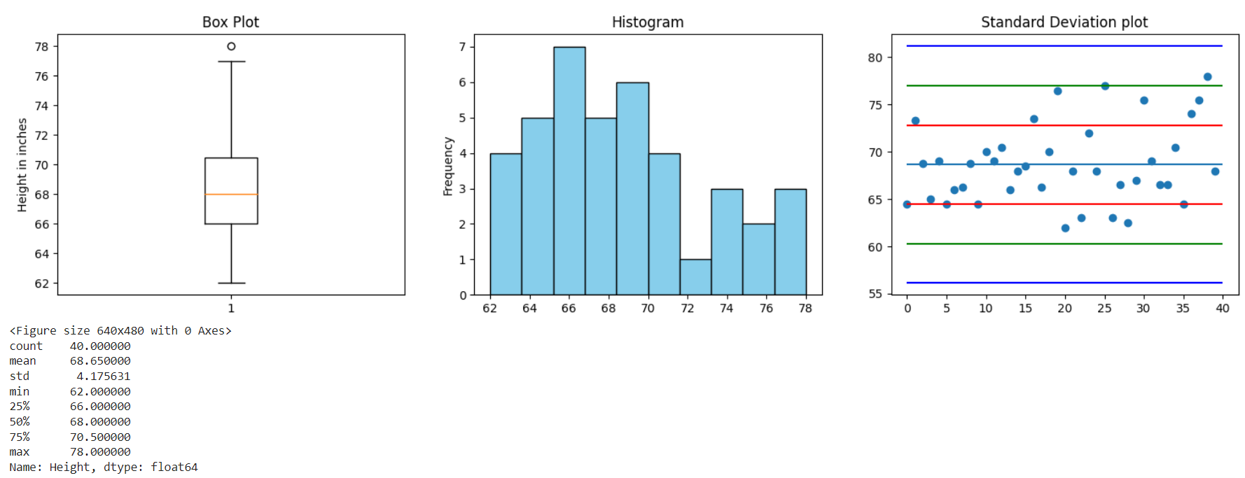
Detail description of Height Variable:
From the boxplot it can be observed that there is an outlier.
From the descriptive stats and boxplot it can be concluded that there is no significant difference between mean and median but due to outlier it is advisable to consider the median to describe this variable.
From the histogram it can be seen that the data is left skewed.
From the standard deviation plot it can be seen that majority of data points lies within 1st quadrant, whereas from boxplot it can be observed that IQR ranges from 66 to 72 inches.
It is noticeable that range and spread of this variable are short.

Slide 5
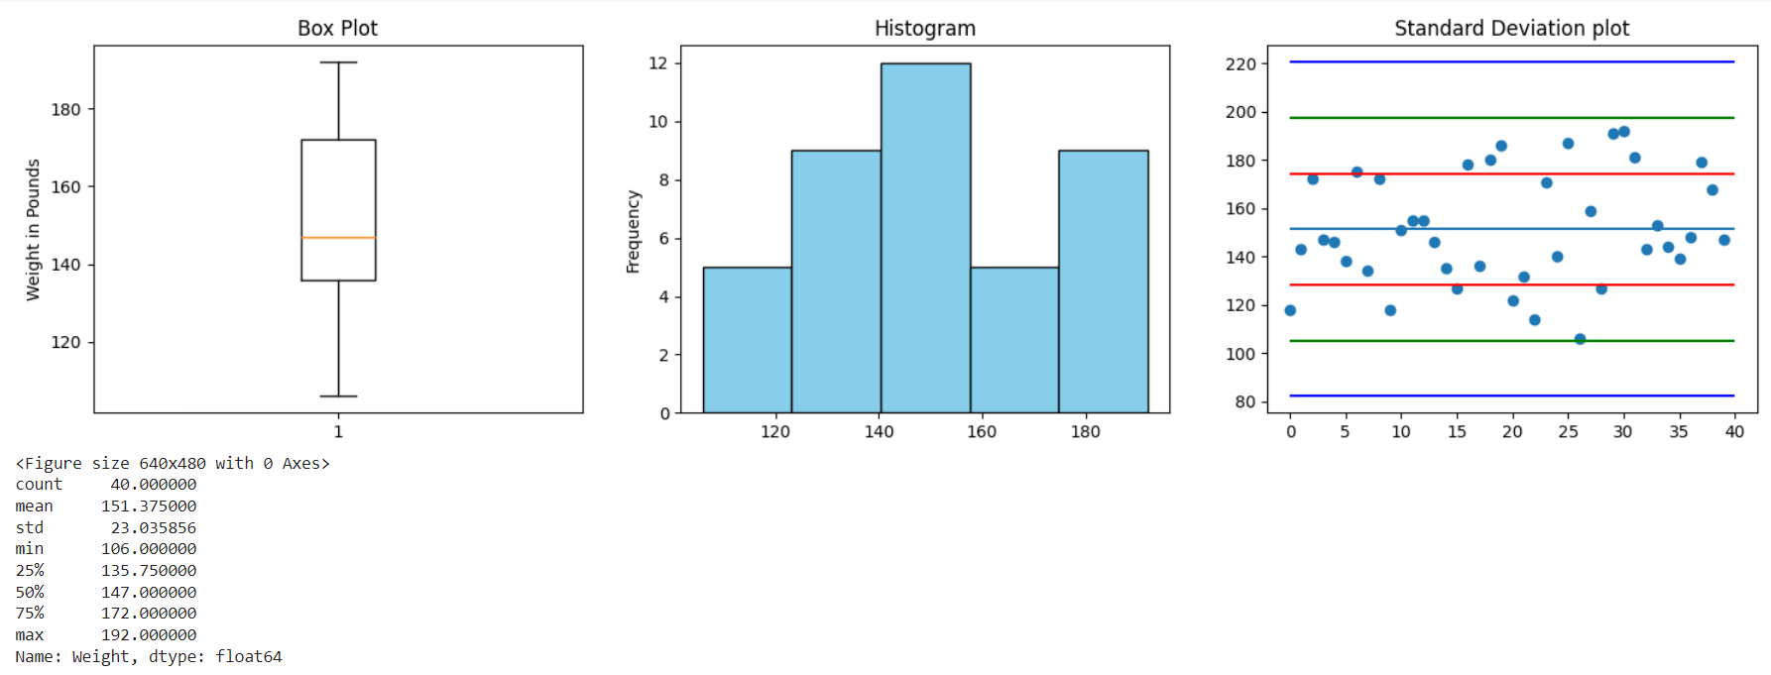
Detail description of Weight Variable:
From the boxplot and standard deviation plot it can be seen that there are no outliers.
From the statistical description and boxplot it can be seen that there is not much difference between mean and median. In addition to that, from the boxplot it can be observed that IQR is from range 135 to 170 lbs.
However for the large range starting from 106 to 192 lbs, the spread of data from mean is nearly 23.03 lbs.

